Slide 2
Absence of Copyright
This slideshow contains photos, diagrams, and information, some of which were attained through internet searches of public websites. The author of this presentation does not own the copyright on this information, so this slideshow is for personal use only—not for sale or profit. Please utilize it to seek the Lord and grow in your knowledge of His Word and ways.
Bro Stan’s Revelation Study is available on our church website:
www.faithprinceton.org

Slide 4
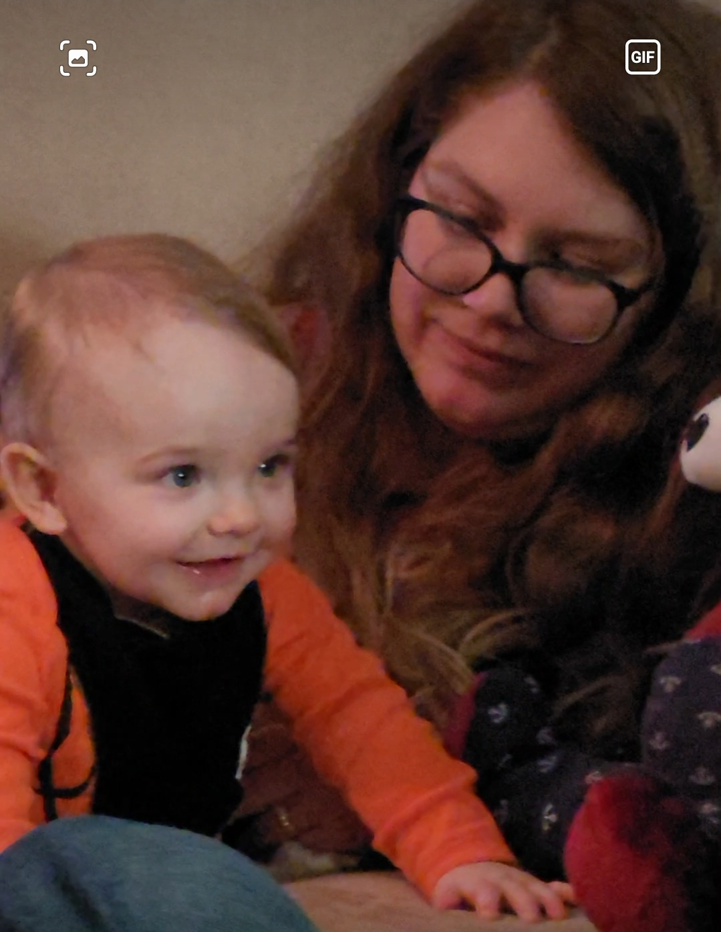
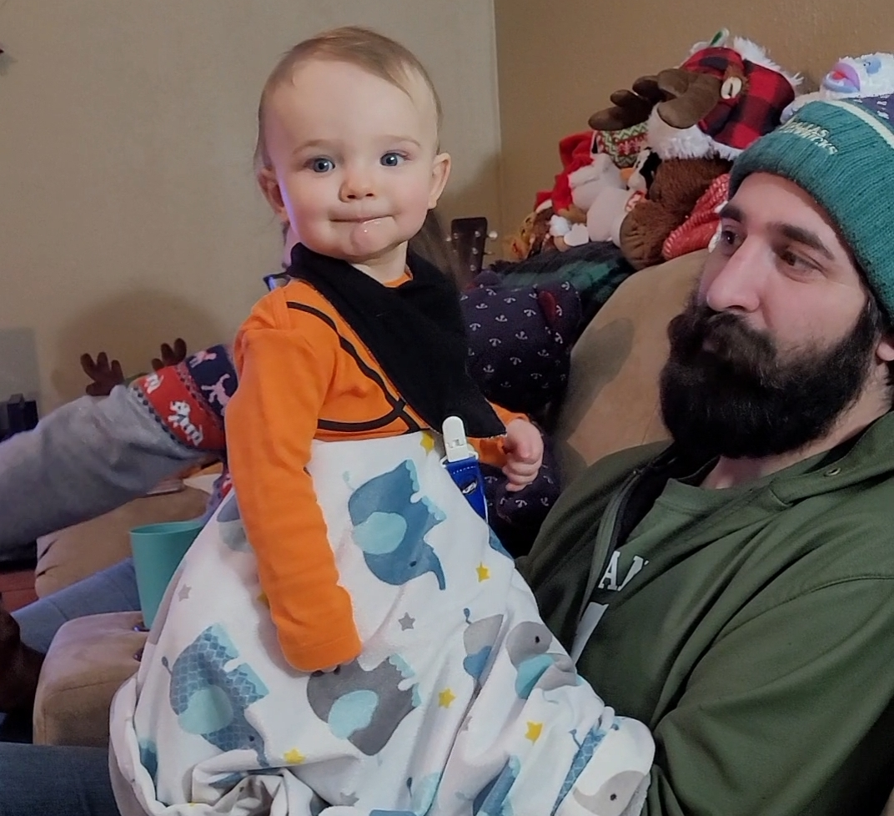
Noah got to meet his Aunt Jessie and Uncle Pete from Portland, Oregon

Slide 5
Prayer and Announcements
Sundays Facebook Live or In-person:
9:15 Small Group Sunday School Classes
10:30 Worship (Facebook or YouTube)
Mask in and Mask out...
Physical distancing recommended

Slide 7
BEGIN HERE January 6, 2021
Week 31 – Revelation 21 b - 22
Making All Things New
Notes:
Revelation 21:1-4
1 Then I saw a new heaven and a new earth; for the first heaven and the first earth passed away, and there is no longer any sea. 2 And I saw the holy city, new Jerusalem, coming down out of heaven from God, prepared as a bride adorned for her husband. 3 And I heard a loud voice from the throne, saying, “Behold, the tabernacle of God is among the people, and He will dwell among them, and they shall be His people, and God Himself will be among them, 4 and He will wipe away every tear from their eyes; and there will no longer be any death; there will no longer be any mourning, or crying, or pain; the first things have passed away.”

Slide 8
Revelation 21:9-27 The New Jerusalem
15 The one who spoke with me had a gold measuring rod to measure the city, its gates, and its wall. 16 The city is laid out as a square, and its length is as great as the width; and he measured the city with the rod, twelve thousand stadia; its length, width, and height are equal. 17 And he measured its wall, 144 cubits, by human measurements, which are also angelic measurements.
Notes:
Measuring the city....
??? Built as a cube??? Length, width, and height are equal
Measurement Numbers:
12,000 stadia = 1500 miles on each side (from Dallas to New York City [1,557 miles] or Los Angeles [1,436 miles]) or Houston to Winnipeg, Canada [1,535 miles]
Tyndale: A city of this size is too large for the imagination to take in. John is certainly conveying the idea of splendour. And, more importantly, that of room for all.
144 cubits = 216 ft.? ??? Height? Or Thickness of the Wall? ???
What would that look like??? How many people would it hold???

Slide 9
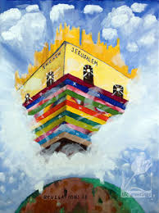
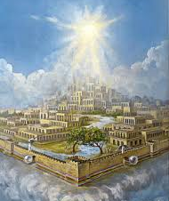
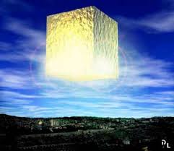
Notes:
Angela Lanehart did some math about how many people it might hold!!! ➔ ➔ ➔

Slide 10
NEW JERUSALEM POPULATION / OCCUPANCY ESTIMATE
-- Math provided by Angela Lanehart (and Microsoft Excel)
1,500.00 Miles Wide
1,500.00 Miles Long
2,250,000.00 SQ Miles
62,726,400,000,000.00 SQ FT
1,500.00 Miles Tall
5,280.00 Ft per mile 7,920,000.00 Feet Tall 15.00 # of Ft per Story
528,000.00 Stories

Slide 11
TOTAL OCCUPANCY:
1,171,142,643.76 Persons @ 53,560 SQ Ft/person PER "story"
(1 acre plus a 10,000 sq ft mansion) x 528,000 STORIES
618,363,315,907,394.00 Total Potential Occupancy
(# persons/story X # stories)
Six hundred eighteen trillion, three hundred sixty-three billion, three hundred fifteen million, nine hundred seven thousand, three hundred ninety-four
Notes:
<angielanehart@gmail.com>
To:
pastor@faithbaptist.org
,
Stan Fike
Wed, Jan 6 at 4:16 PM
My friend Shirley says I should have included an acre for everyone LOL and advises she expects some beaches and mountains. So, attached are new estimates. Still 5,000-13,000 times more than everyone who has ever lived.
A

Slide 12
TOTAL HUMAN POPULATION:
45,000,000,000.00 Total # of persons who ever lived
- Low estimate by Christianforum.com
108,000,000,000.00 Total # of persons who ever lived
- High estimate by Christianforum.com
TOTAL ESTIMATED OCCUPANCY:
618,363,315,907,394.00
13,741.41 Times more than total number of people
who ever lived using Low Estimate 5,725.59 Times more than total number of people
who ever lived using High Estimate

Slide 13
LESSON: There’s Plenty of Room for YOU!
MY FATHER’S HOUSE:
Come and go with me to my Father’s House...
Come and go with me to my Father’s House...
It’s a BIG, BIG House with lots and lots of ROOM.
It’s a BIG, BIG Table with lots and lots of FOOD.
It’s a BIG, BIG Yard where we can PLAY football.
It’s a BIG,BIG House!
It’s My Father’s HOUSE!
Notes:
Dawson McAllister Conference song.
He just passed away Dec 17, 2020 of heart issues.
Used to have Mercy Me as the worship leaders before they were famous.

Slide 14
Revelation 21:9-27 The New Jerusalem
22 I saw no temple in it, for the Lord God the Almighty and the Lamb are its temple. 23 And the city has no need of the sun or of the moon to shine on it, for the glory of God has illuminated it, and its lamp is the Lamb. 24 The nations will walk by its light, and the kings of the earth will bring their glory into it. 25 In the daytime (for there will be no night there) its gates will never be closed;
Notes:
Tyndale: 22. John did not see a temple (‘sanctuary’, naos), for God is its sanctuary (and its members are all priests, 20:6). The heaping up of titles, Lord, God and Almighty is impressive. Each has been used before, but the cumulative effect adds splendour. In the last state of things it is God’s presence alone that counts, and that is not confined to any one part of the city. It is characteristic that John adds and the Lamb. The Lamb is at the centre of things throughout this book.
???? the Lord God the Almighty and the Lamb are its temple ... And its light and lamp...
New Jerusalem described as a cube... The Holy of Holies was a cube (30 cubits wide, long, and high)
New Jerusalem is the Holy of Holies for the new heaven and earth??? The presence of God abides there.
We are a kingdom of priests...
New Bible Commentary: 23 Is. 60:19-20 is clearly in mind. It is not that the sun or the moon have ceased to exist but that their splendour has been surpassed by the glory of God himself.
24-26 These verses reproduce the substance of Is. 60:3-11, but with a difference: there the nations bring Jewish exiles to Jerusalem and their wealth to Jews; here they bring their splendour... glory and honour to God and the Lamb, so fulfilling 15:4.

Slide 15
Revelation 21:9-27 The New Jerusalem
26 and they will bring the glory and the honor of the nations into it; 27 and nothing unclean, and no one who practices abomination and lying, shall ever come into it, but only those whose names are written in the Lamb’s book of life.
Notes:
its gates will never be closed; 26 and they will bring the glory and the honor of the nations into it
“It is built for beauty, not defense. Its walls are low and its gates are always open.” (Fritz Foltz) at https://www.frontlinestudy.com/revelation/new-jerusalem-in-revelation/
nothing unclean, and no one who practices abomination and lying
Tyndale: 26–27. John has described a city so wonderful that it is hard to see what the glory and honour of the nations could bring to it. He probably means, not that the nations add to its splendour, but that they render their homage. Some things cannot enter the city. Nothing impure is comprehensive, and John singles out two specifics: anyone who does what is shameful or deceitful (see note on v. 8). What is shameful probably has special reference to idolatry, and lying is reprobated elsewhere in this book. It is important that people speak truth and act truly. Smith rightly points out that ‘one may be guilty of working or acting a lie without saying a single word’. Every lie is excluded from the heavenly city. By contrast, those who do enter are those whose names are written in the Lamb’s book of life. Again there is the thought that salvation depends on what Christ has done.

Slide 16
Revelation 22 Come, Lord Jesus, Come

Slide 17
Revelation 22:1-2 Water and Tree of Life
1 And he showed me a river of the water of life, clear as crystal, coming from the throne of God and of the Lamb, 2 in the middle of its street. On either side of the river was the tree of life, bearing twelve kinds of fruit, yielding its fruit every month; and the leaves of the tree were for the healing of the nations.
Notes:
New Bible Commentary
22:1-5 This conclusion of the vision of the city of God shows conscious links with the description of the paradise in Eden (Gn. 2-3).
1 The throne of God and of the Lamb is the source of the river of the water of life (cf. 7:17; 21:6; 22:17). The Garden of Eden had a river (Gn. 2:10). In Ezekiel’s vision a river flowed from the temple (Ezk. 47:9;
see the application of this passage to Jesus in Jn. 7:37-38 ³⁷ On the last and greatest day of the festival, Jesus stood and said in a loud voice, “Let anyone who is thirsty come to me and drink. ³⁸ Whoever believes in me, as Scripture has said, rivers of living water will flow from within them.” ³⁹ By this he meant the Spirit, whom those who believed in him were later to receive. Up to that time the Spirit had not been given, since Jesus had not yet been glorified..
ALSO John 4 with woman at the well.
2 The tree of life (unlike Gn. 2:9; 3:22, but as in Ezk. 47:7ff) is viewed collectively. Like the symbol of the water of life, the healing powers of the leaves are taken in a spiritual sense, possibly in the first instance for the healing of the wounds inflicted in the great distress.
12 kinds... Every month... (no moon or sun.... How is time measured in heaven???)
Continuous and always available
3 No longer will there be any curse cites Zc. 14:11 and reverses the curse pronounced in the original paradise (Gn. 3:14-19). In the new Jerusalem the effects of that curse are completely overcome.
Tyndale: He goes on to tell us that the leaves of the tree bring healing to the nations (cf. Ezek. 47:12). This provokes the question, ‘Healing from what?’ We would naturally think of healing from sin were it not that every such thing is excluded (21:27). Walvoord takes the word to mean ‘health-giving’ and comments, ‘The leaves of the tree promote the enjoyment of life in the new Jerusalem, and are not for correcting ills which do not exist.’

Slide 18
Revelation 22:3-5 No More Curse
3 There will no longer be any curse; and the throne of God and of the Lamb will be in it, and His bond-servants will serve Him; 4 they will see His face, and His name will be on their foreheads. 5 And there will no longer be any night; and they will not have need of the light of a lamp nor the light of the sun, because the Lord God will illuminate them; and they will reign forever and ever.
Notes:
Tyndale:
We are reminded that Ezekiel ends his prophecy by telling us that the name of the city is ‘THE LORD IS THERE’ (Ezek. 48:35). Where God and the Lamb rule there is no accursed thing.
On the contrary, God’s servants render service. The verb latreuousin (serve) has overtones of worship, and indeed NEB translates ‘his servants shall worship him’.
See His face = 1 John 3:1-3 1 See how great a love the Father has given us, that we would be called children of God; and in fact we are. For this reason the world does not know us: because it did not know Him. 2 Beloved, now we are children of God, and it has not appeared as yet what we will be. We know that when He appears, we will be like Him, because we will see Him just as He is. 3 And everyone who has this hope set on Him purifies himself, just as He is pure.
Name on forehead ➔ ownership? Seal? Proud display? Bear the name [CHRISTian]?
5. Once more we are assured that there is no more night there (21:23, 25; cf. Zech. 14:7) and that God gives them light.
The section culminates with the assurance that they will reign for ever and ever. It is not said that they will reign over anyone, and, indeed, it is difficult to see who their subjects could be. The term indicates a blessed and exalted state. They share in royalty.
Hierarchy in heaven? Jobs? Positions of authority? Rewards? Decisions? Growth?
SO MUCH WE DON’T KNOW !!!

